Slide 1
Title
Eetu Ervasti, Niklas Riikonen & Aapo Juutinen

Slide 2
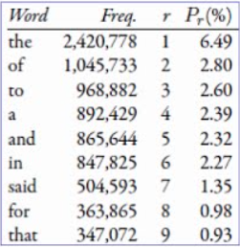
Abstract
Zipf’s law states that rank of the word times its probability (frequency) is approximately a constant. In this project, we aim to validate Zipf’s law on a English wikipedia corpora containing [montako artikkelia sielä nyt onkaan].
r × Pr ≈ constant

Slide 3
Topics investigated/Relevant prior work
Topics investigated:
Zipf Law
Validation
Relevant prior work:
Zipf’s word frequency law in natural language: A critical review and future directions, Steven T. Piantadosi

Slide 4
Delineation of group member responsibilities
Eetu:
Niklas:
Aapo:

Slide 5
Data sources/Technologies/Existing tools
Wikipedia dump file
Technologies: Python
Existing tools: ?

Slide 6
Implementation details
Building wikipedia text corpus from wikipedia dump file using python
Wikipedia dump downloaded from https://dumps.wikimedia.org/enwiki/latest/
Have a glimpse of the data by plotting the 30 most frequent words in the corpus
To check and validate Zipf’s law, we plotted log(frequency) vs log(rank) from the words present in corpus
Rank = The most frequent words rank is 1, second most frequent words rank is 2 and so on
Further investigation of Zipf’s law by quantifying the good of fit of the law using the statistical confidence bound at 90%

Slide 7
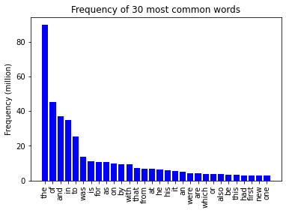
Results: Task 1

Slide 8
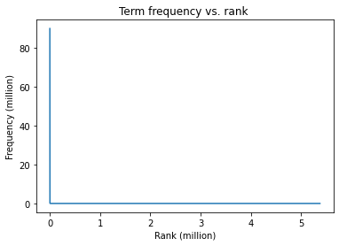
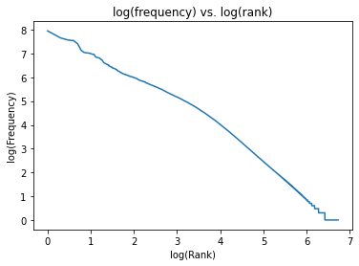
Task 2 saako näitä samalle dialle?

Slide 9
Task 3

Slide 10
Task 4

Slide 11
Time-chart diagram future tasks of future tasks. Tämä ei kyllä taida olla ihan se mitä pyydettiin?
Presentation 22.10
2.11-7.11
26.10-1.11
Deadline 8.11

